Slide 1

Cleckhuddersfax
Work In Progress
E-Convenient Store

Slide 2
INTRODUCTION

Slide 3
PRESENTING TIME
A TOTAL OF 20 MINUTES HAS BEEN ALLOCATED
Swastika Adhikari
Utsav Sapkota
Sakriya Bajracharya
3 Minutes
4 Minutes
6 Minutes
Sujan Pariyar
Prashanna Shrestha
4 Minutes
3 Minutes

Slide 4
SLIDE DIVISION
1
2
3
Swastika Adhikari
Utsav Sapkota
Sakriya Bajracharya
Topics Covered
Topics Covered
Topics Covered
5
4
Topics Covered
Topics Covered
Prashanna Shrestha
Sujan Pariyar

Slide 5


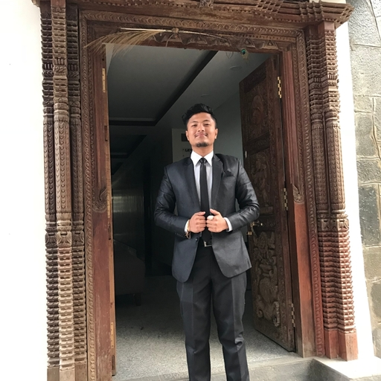


OUR TEAM
PROJECT MANAGER — SIR ROHIT RAJ PANDEY
PROJECT CUSTOMER — Citizens of Cleckhuddersfax
PROJECT SPONSOR: — The British College, Thapathali, Kathmandu
Swastika Adhikari
Utsav Sapkota
Sakriya Bajracharya
Implementer / Resource Investigator / Specialist
Plant / Team Worker / Monitor Evaluator
Complete Finisher / Specialist / Co-ordinator
Sujan Pariyar
Prashanna Shrestha
Monitor Evaluator / Shaper / Co-ordinator
Resource Investigator / Shaper / Team Worker

Slide 6
OBJECTIVES
OBJECTIVES OF OUR PROTOTYPE WEB BASED
E-COMMERCE SYSTEM IS LISTED
Attract local people who cannot shop during a normal opening hour to order and purchase things in a brief period of time.
Help the local traders to compete against the bigger business without losing their family time.
Promote the local tradition of area.
Introduce the customers to high quality limited as well as unique products and fresh goods.
Expand trade by adding more traders within a group.
Three days a week to collect the products ordered.
Provide a wonderful opportunity to customers to browse and buy products from the ease of the comfort zone.
Eliminate the travel time and cost for customers.
Create simple user interface to understand by all types of user, trader and accessible through web interface and most popular browsers.

Slide 7

Estimated Time
Hours per day per person: 3 – 4 Hours
Hours Per Week Per Person: 18 – 24 Hours | Team of 5 Members
Hence Total Hours Till 12th Week: 18 * 5 * 12 = 1080 Hours
Max: 24* 5* 12 = 1440 hours

Slide 8
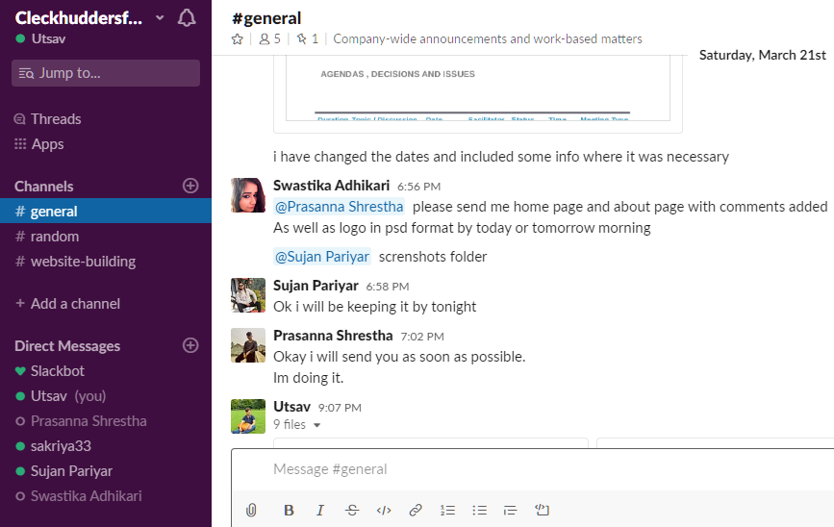
Tools and Techniques Used
Slack (Android/IOS app for instant communication and update)
MS Project for project management and monitoring

Slide 9
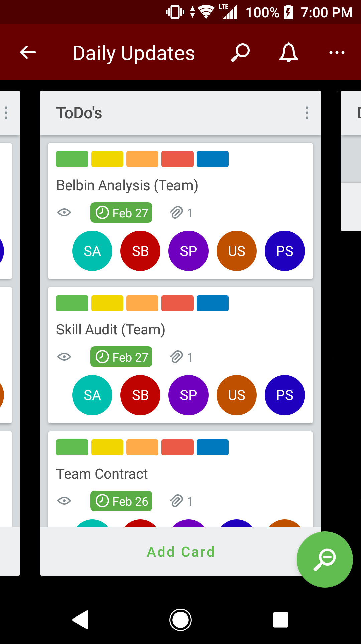
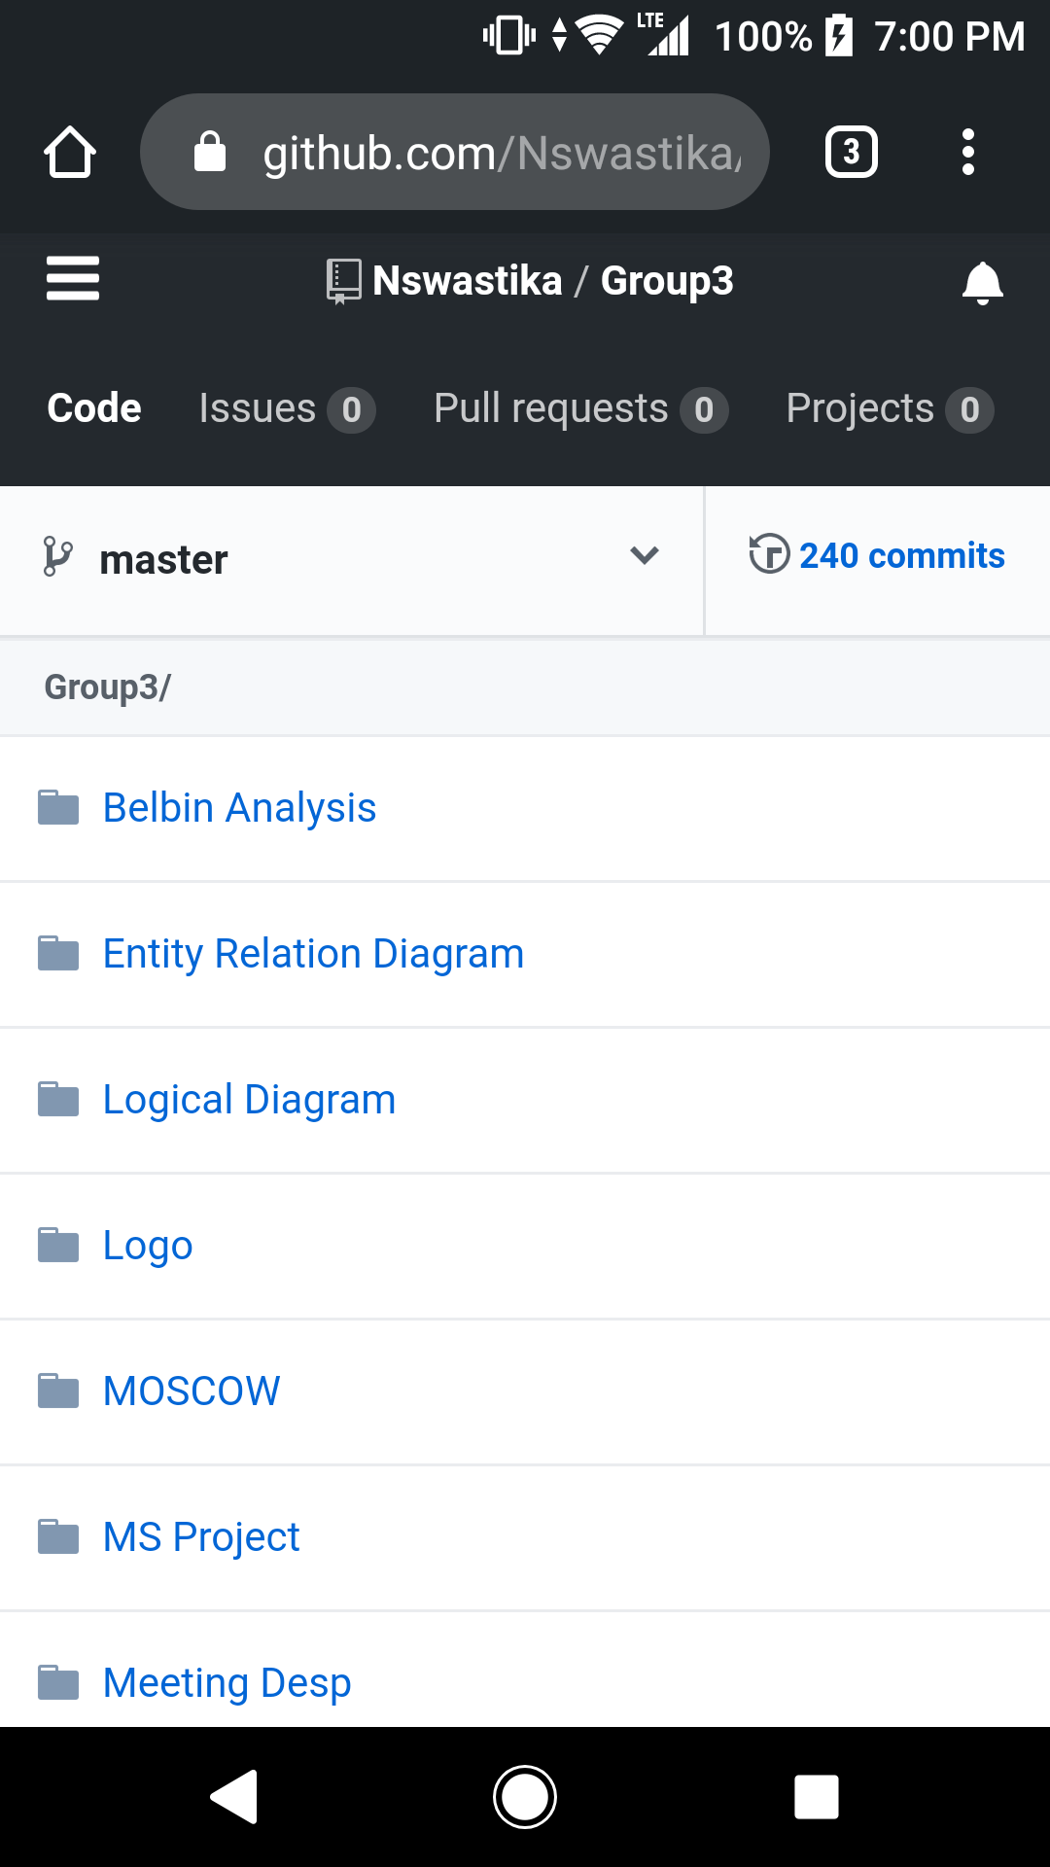
Tools and Techniques Used
FROM PROJECT CHARTER
Trello for task scheduling
GitHub to store our work
Documentation - A shared One Drive space will be used to store all the documentations generated on the project.
Team Meetings in person – Every Mondays and Thursdays

Slide 10


CUSTOMER INTERFACE
Select the products from 5 traders in the initial phase.
Sort the products by shop or by product type.
Capture the heritage of the Cleckhuddersfax area.
Interface viewable on all major browsers and will be compatible in both mobile and desktop view.
A cart function that can hold the products from all the traders..
Registration system in order to place an order.
Login system in order to access their basket/cart by customers.
Review and update customer account details.
Confirm the changes made in customer registration and account update through the emails that they used for registration.
Pick up the orders in three slots in three different days i.e. 10-13, 13-16, 16-19 in the days Wednesday, Thursday and Friday.
Place the orders 24 hours before the desired pickup time and day.
PayPal function for the payment.

Slide 11

TRADER INTERFACE
Manage product and information.
Able to add, delete and update product through trader account. When a Trader adds a product, the product will have a Unique ID, Short Name, Description, Item Price, Min Order, Max Order, Allergy Information which must be added by the Trader.
Login the Database using trader account that shows the reports of the available stock and report of orders.
Unique login Credentials of every trader which shows their details only.
Admin login that can access the whole system.

Slide 12

MANAGEMENT INTERFACE
Dashboard that has a range of daily and periodic reports.
Daily report on the orders placed that contain the products and quantities which has been ordered and also shows which delivery slots are used.
Weekly finance report which shows the number of products that is sold along with the payment for the last 7 days which will only include the orders that have been delivered.
Access all of the traders accounts.
Monthly report of the product sales which can be sorted alphabetically; total numbers of orders per products or total income per product.

Slide 13

MAJOR DELIVERABLES
FROM PROJECT CHARTER
E-Commerce website with customer, trader and management interface.
Management interface connected with database.
Registration system to place an order by customer.
Single basket to add products from different traders.
Login system to access the cart.
Website supporting a maximum of ten shops for initial pilot project.
Traders’ interface that allows add/delete/update products on their corresponding shops.

Slide 14
MAJOR DELIVERABLES Continued...
FROM PROJECT CHARTER
Responsive design viewable on mobile as well as desktop devices and viewable on the most popular browsers.
User-friendly navigation of products by shop or product type for customers..
An admin login for management interface that can access any of the trader accounts.

Slide 15
MAJOR DELIVERABLES Continued...
FROM PROJECT CHARTER
A maximum of 20 orders per slot for 3 collection slots 10:00-13:00, 13:00-16:00, 16:00-19:00 on Wednesdays, Thursdays and Fridays which must be at least 24 hours after placing the order.
PayPal is used for online payment which is secure.

Slide 16
Functional Requirements
Part A: Product Interface
Requirement ID | Description | MoSCoW
A1 | An interface to allow customers to view products and buy them.
A1 – 1 | All products will be displayed with a short name, a description, price, quantity, stock available, min order, max order, allergy information and will be associated with a trader. | M
A1 – 2 | Users will be able to navigate to product by shop or by product type. | M
A1 – 3 | Users will be able to search for products by open text search. | S
A1 – 4 | Users will be able to sort products appropriately. Example: price, alphabets. | S
A1 – 5 | Users will be able to search/sort items based on multiple search criteria. | C
A2 | The interface will allow customers to select products and add those products to cart for checkout.
A2 – 1 | Logged in users will only be able to access the cart. | M
A2 – 2 | Registration should be done in order to login and add products to cart. | M
A2 – 3 | Users will be provided with a single cart to hold goods that spans all traders. | M
A2 – 4 | A single cart will have a single payment. | M

Slide 17
Part A: Product Interface Contd..
A2 – 5 | While placing and paying for an order collection slots should be identified in three slots in three different days i.e. 10-13, 13-16, 16-19 in the days Wednesday, Thursday and Friday. | M
A2 – 6 | A cart will contain all the products added by the customer with name, short description, quantity and an image. | S
A2 – 7 | A single cart can hold up to 20 products and a single payment is needed. | C
A3 | The interface to allow CRUD operations of products.
A3 - 1 | Traders can add, delete and update products. | M
A3 – 2 | Clicking the update will show a form pre-populated with all the details of the products. Submitting the form will update the chosen product and display the updated information of that product. | S
A3 – 3 | A form will be provided to add a new product including all details and image. | S
A3 – 4 | Clicking the delete will remove the chosen product and update the displayed catalogue of products. | S
A3 - 5 | Management can delete the products that have very low sales. | S

Slide 18
Part B: Customer Interface
Requirement ID | Description | MoSCoW
B1 | A facility to allow registered users to login
B1 - 1 | A login form to collect username and password will be provided. | M
B1 – 2 | Server validation that informs users if they attempt to login using incorrect details. | M
B1 – 3 | Login link will be displayed on every pages of the site. | C
B1 - 4 | Reset password link will be provided if they forget their password. | C
B2 | A facility to allow new customers to register their account.
B2 - 1 | A registration form that collects first name, last name, user name, password, email, address, age. | M
B2 - 2 | A user should be able to validate account through email address. | M
B2 - 3 | Customer account must be registered before they can place an order. | M
B2 – 4 | Username must be unique to each customer. | M
B2 – 5 | Account updates should be confirmed through emails. | M
B2 – 6 | Validation of all form fields to ensure none of the field is empty or unchecked. | S
B2 – 7 | Password must be encrypted before storing in the database. | C
B2 – 8 | The password length must be 8-10 length. | C
B2 – 9 | The username must have alphabets only. | C
B2 – 10 | The password must have at least one capital letter, a number and a symbol. | C

Slide 19
Part C: Trader Interface
Requirement ID | Description | MoSCoW
C1 | An interface to allow trader to register their account.
C1 – 1 | A form that minimally collects user id, user role, status, first name, last name, profile picture, status, dob, email. | M
C1 – 2 | Username must be unique to each trader. | M
C1 – 3 | Validation of all form fields to ensure none of the field is empty or unchecked. | S
C1 – 4 | Password must be encrypted before storing in the database | C
C2 | An interface to allow registered trader to login.
C2 – 1 | A trader login that allows them to access to their details only. | M
C2 – 2 | A login form to collect username and password will be provided. | M
C2 – 3 | Server validation that informs users if they attempt to log in using incorrect details. | M
C2 – 4 | Trader should be able to view and update the details of their trader account. | M
C2 – 5 | Trader login will allow them to view reports on orders and stock levels. | M
C2 – 6 | Reset password link will be provided if they forget their password. | C

Slide 20
Part D: Management Interface
Requirement ID | Description | MoSCoW
D1 | A facility to allow authenticated admin users to manage the activities presented by the system.
D1 – 1 | After logging in the admin will have the access to manage the dashboard. | M
D1 – 2 | An interface to view the shop of each trader. | M
D1 – 3 | Management can deactivate customers account. | C
D1 – 4 | An interface will provide the traders access to range of daily reports of orders placed, weekly report of products sold and monthly report of sales. Monthly report will be able to be sorted alphabetically; total numbers of orders per products or total income per product. | M
D1 – 5 | Email confirmation should be sent to trader after signing up. | S
D1 – 6 | An interface to view the shop details of each trader. | S

Slide 21
Non - Functional Requirements
Part E: Non – functional Requirements
Requirement ID | Description | MoSCoW
E1 | The website will have the following non-functional requirements.
E1 - 1 | HTML/CSS template suited to the requirements. | M
E1 – 2 | The site should be viewable on mobile as well as desktop devices and viewable on the most popular browsers. | M
E1 – 3 | Apex Oracle used for the back-end. | M
E1 – 4 | Site built for maintainability: Files organized and comments added. | S
E1 – 5 | Template applied consistently throughout the website. | S
E1 - 6 | Implement Google map to locate the shops location. | W

Slide 22

LOGO DESIGN

Slide 23
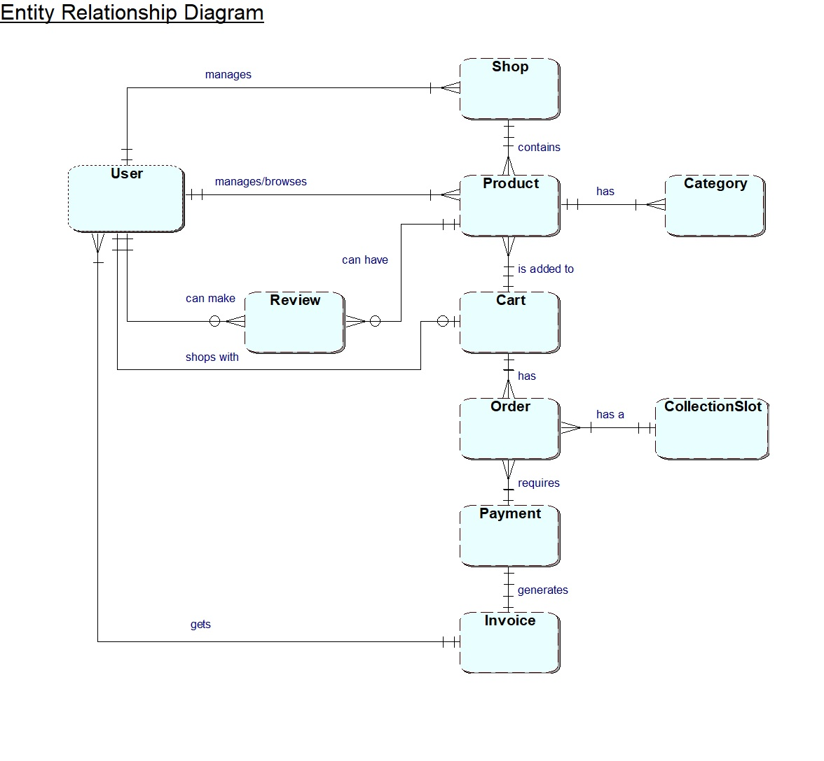
ERD

Slide 24
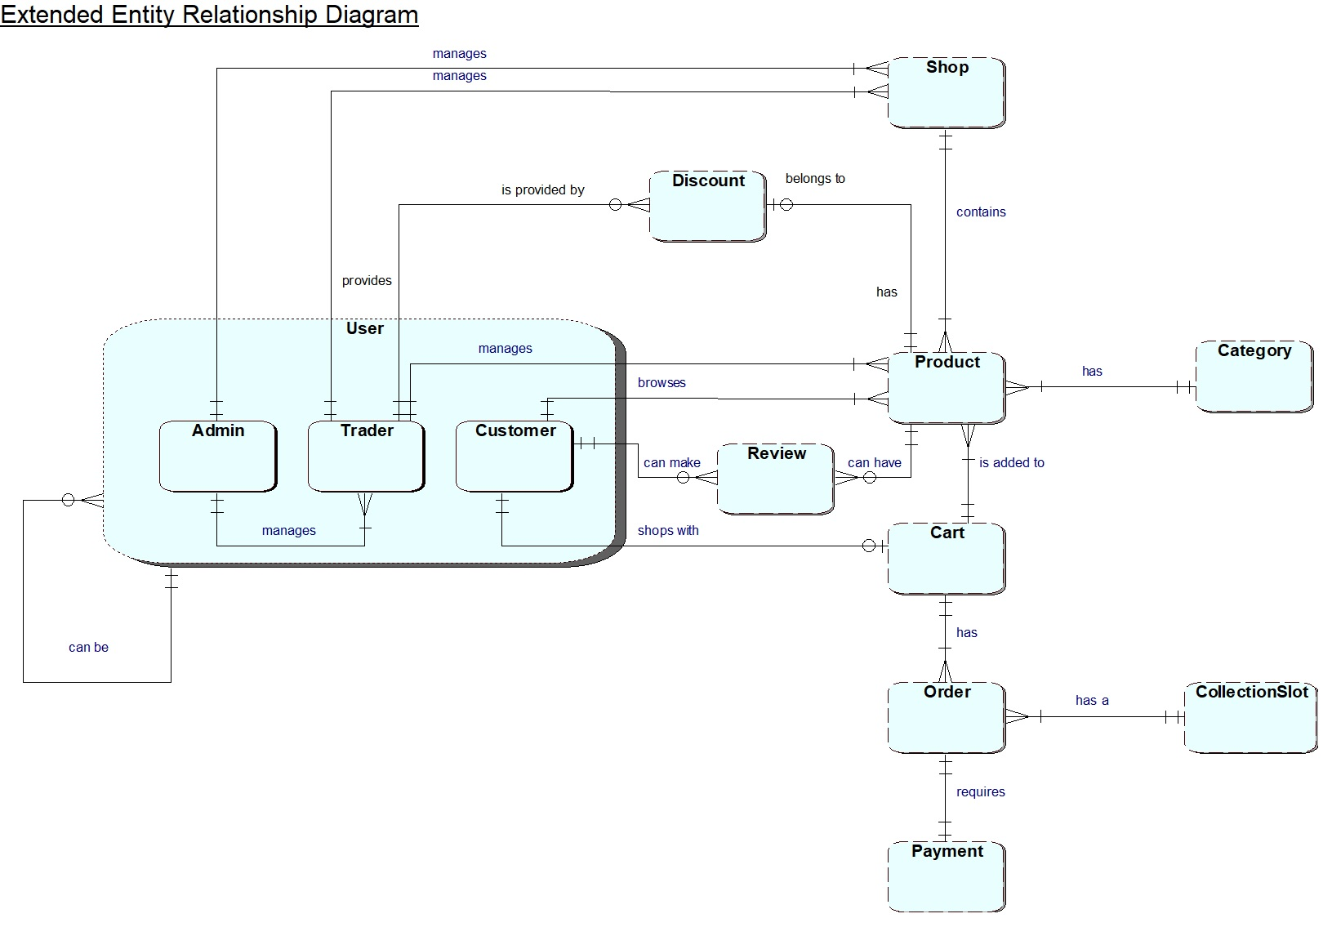
EERD

Slide 25
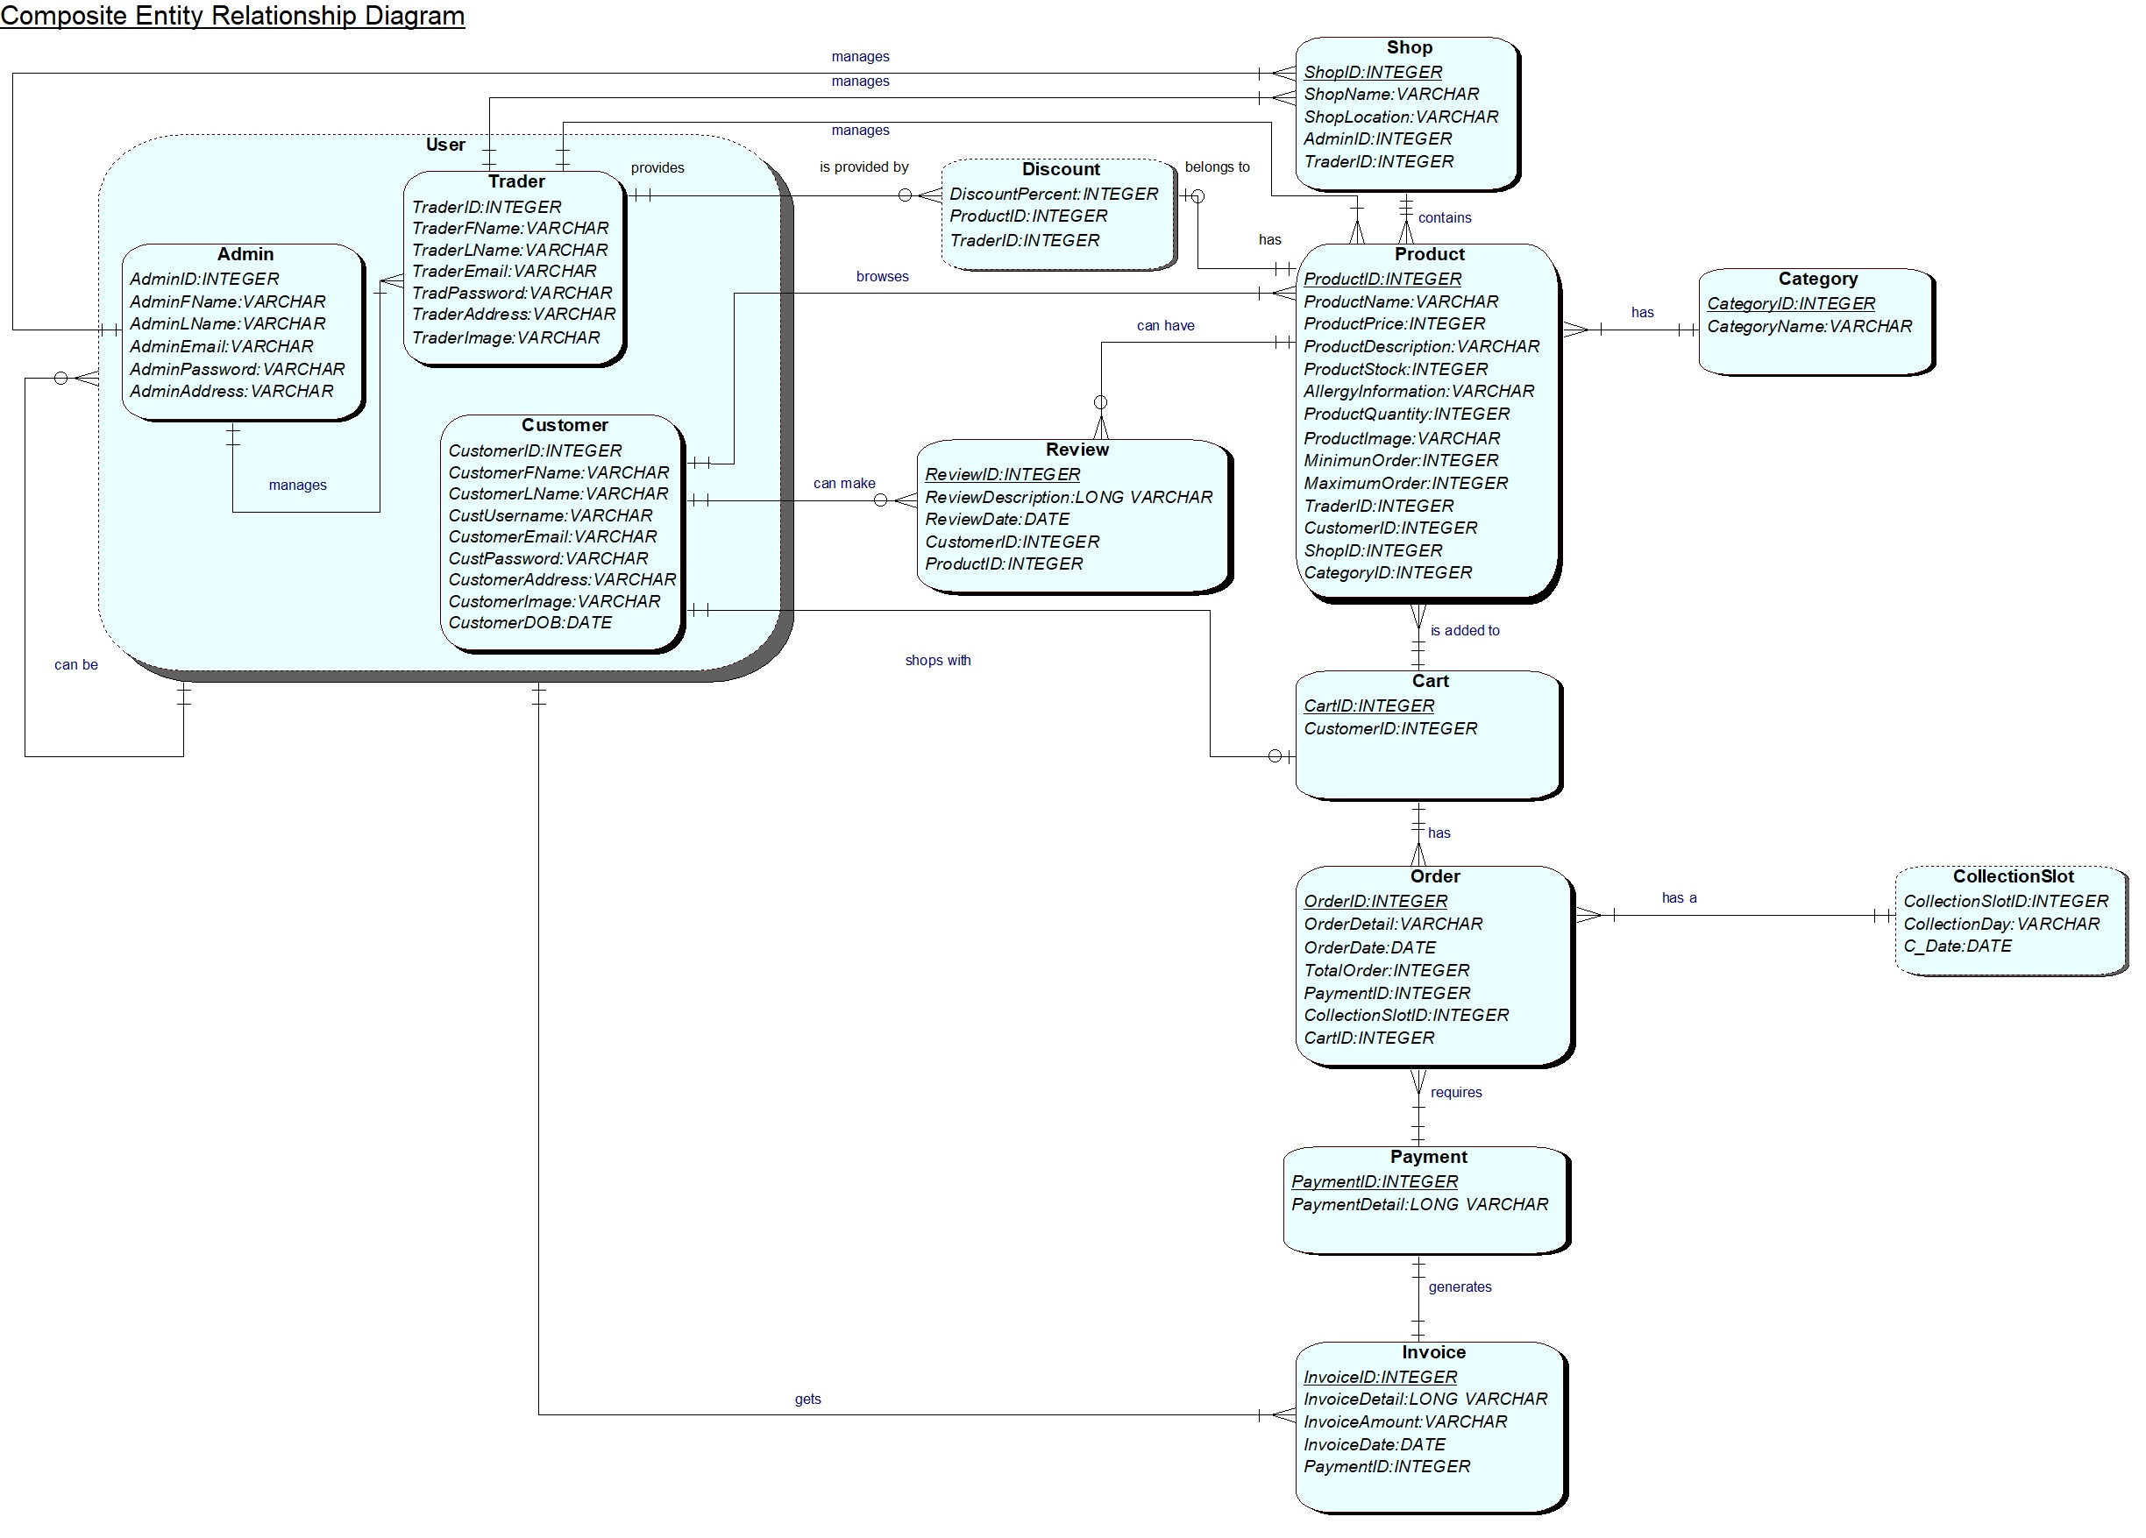
COMPOSITE ERD

Slide 26
LOGICAL DIAGRAM
LOGICAL DIAGRAM
Admin (AdminID, AdminFName, AdminLName, AdminEmail, AdminPassword, AdminAddress, AdminImage);
Trader (TraderID, TraderFName, TraderLName, Trader_Email, TraderPassword, TraderAddress, TraderImage);
Customer (CustomerID, CustomerFName, CustomerLName, CustomerUsername, CustomerEmail, CustomerPassword,
CustomerAddress, CustomerImage, CustomerDOB);
Discount (Discount_ID, DiscountPercent, ProductID, TraderID);
Shop (ShopID, ShopName, ShopLocation, AdminID, TraderID);
Category (CategoryID, CategoryName, Category_Image);
Product (ProductID, ProductName, ProductPrice, ProductDescription, ProductStock, AllergyInformation,
ProductQuantity, ProductImage, MinimumOrder, MaximumOrder, TraderID, CustomerID, ShopID, CategoryID);
Cart (CartID, P_Image, P_Desc, P_Price, P_Quantity, CustomerID);
Order (OrderID, OrderDetail, OrderDate, TotalOrder, CollectionSlot, PaymentID , CartID);
Payment (PaymentID, PaymentDetail);
Invoice (InvoiceID, InvoiceDetail, InvoiceAmount, InvoiceDate, PaymentID);
Review (ReviewID, ReviewDate, CustomerID, ProductID);

Slide 27
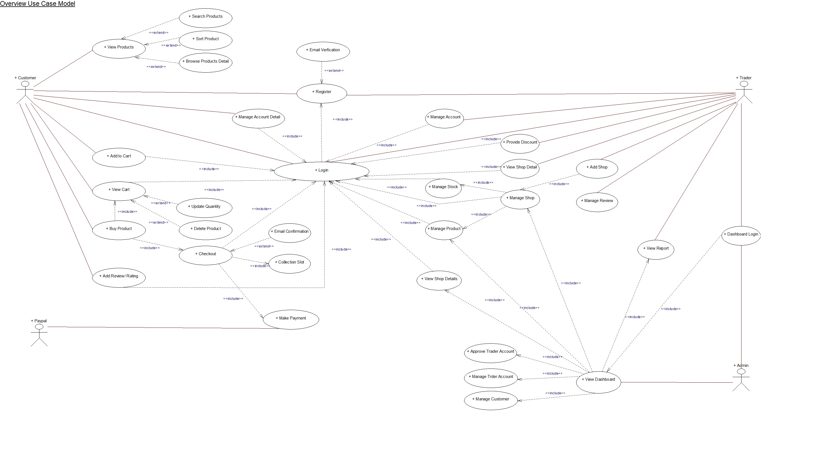
OVERVIEW USE CASE DIAGRAM

Slide 28
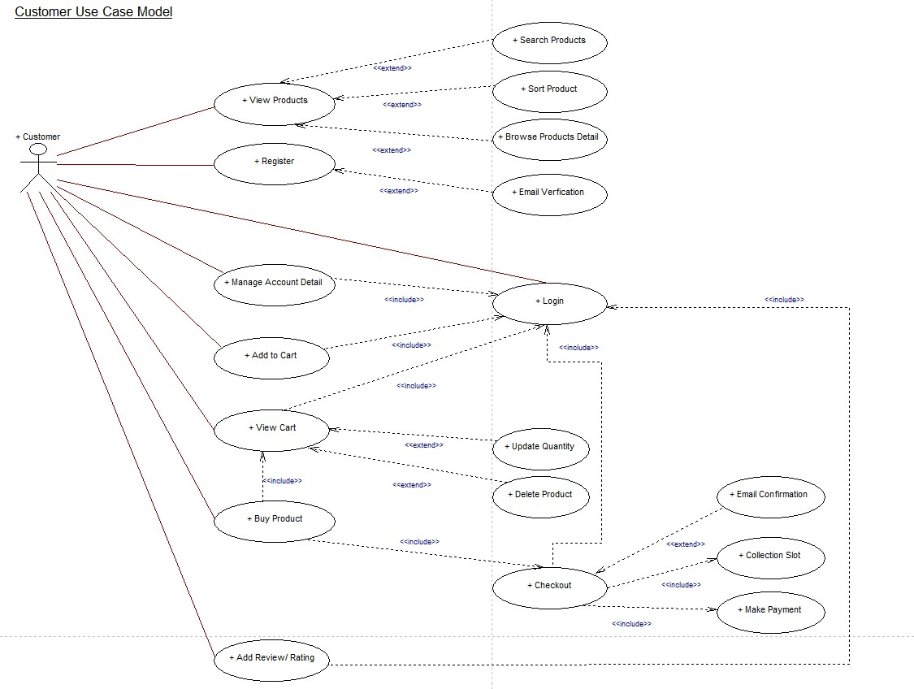
CUSTOMER INTERFACE USE CASE DIAGRAM

Slide 29
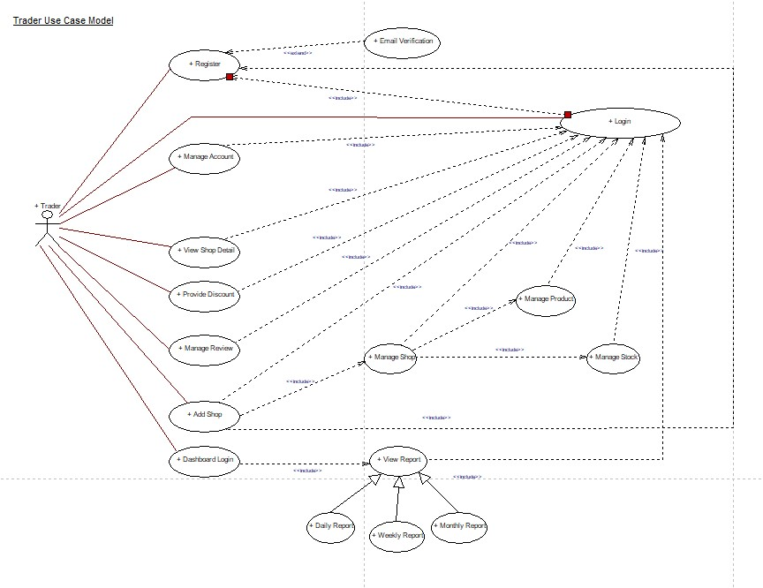
TRADER USE CASE DIAGRAM

Slide 30
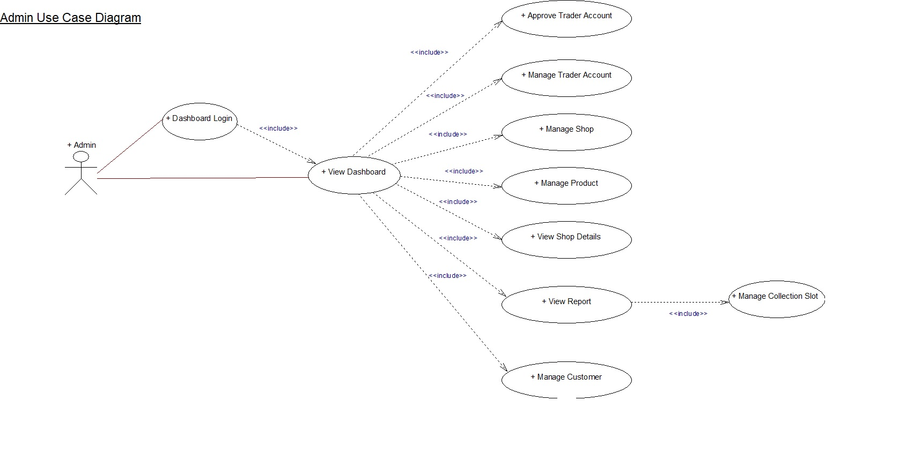
ADMIN INTERFACE USE CASE DIAGRAM

Slide 31
MS-PROJECT
Gantt Chart

Slide 32
Gantt Chart

Slide 33
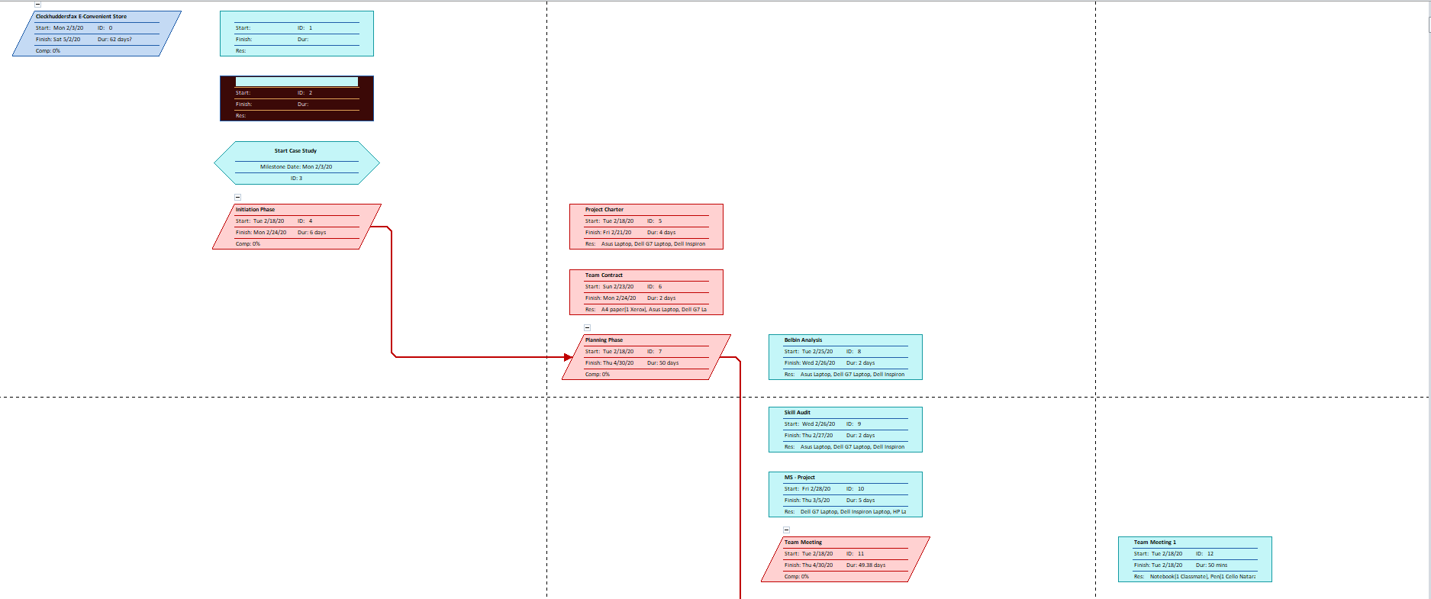
Network Diagram

Slide 34
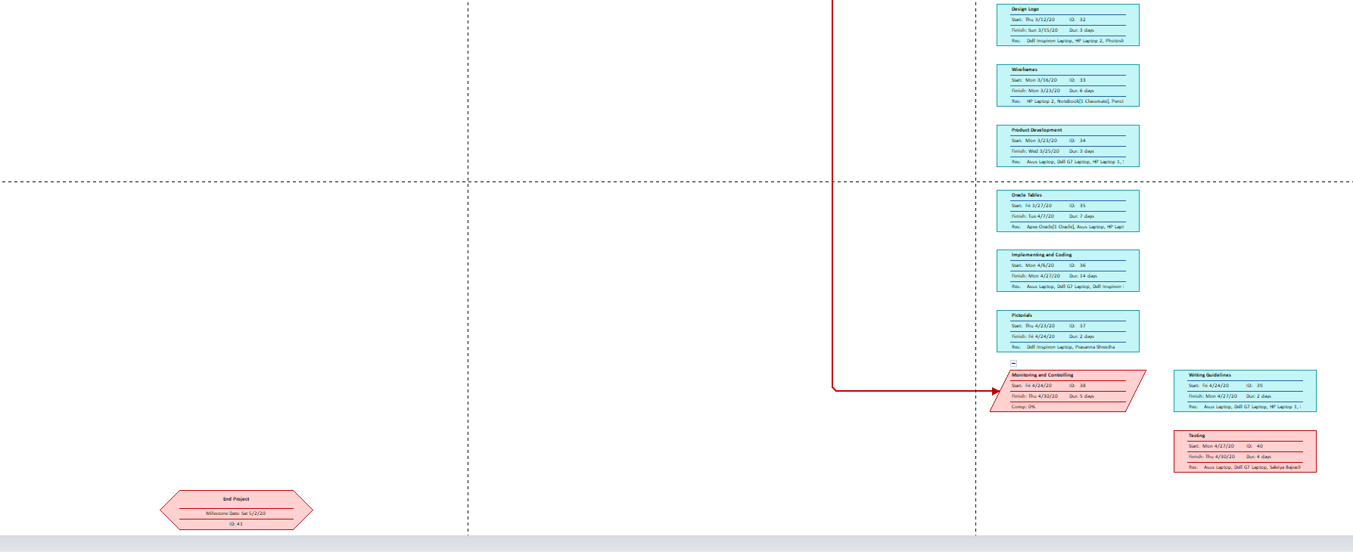
Network Diagram

Slide 35
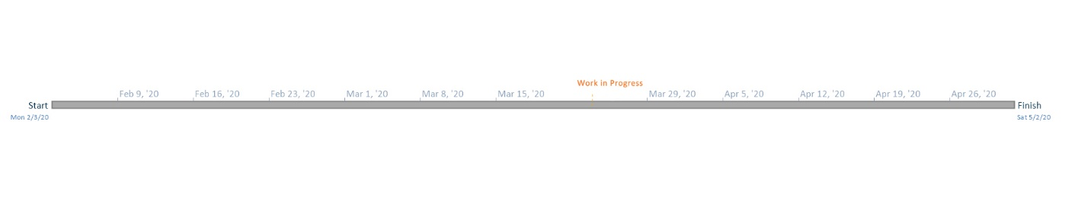
TIMELINE

Slide 36
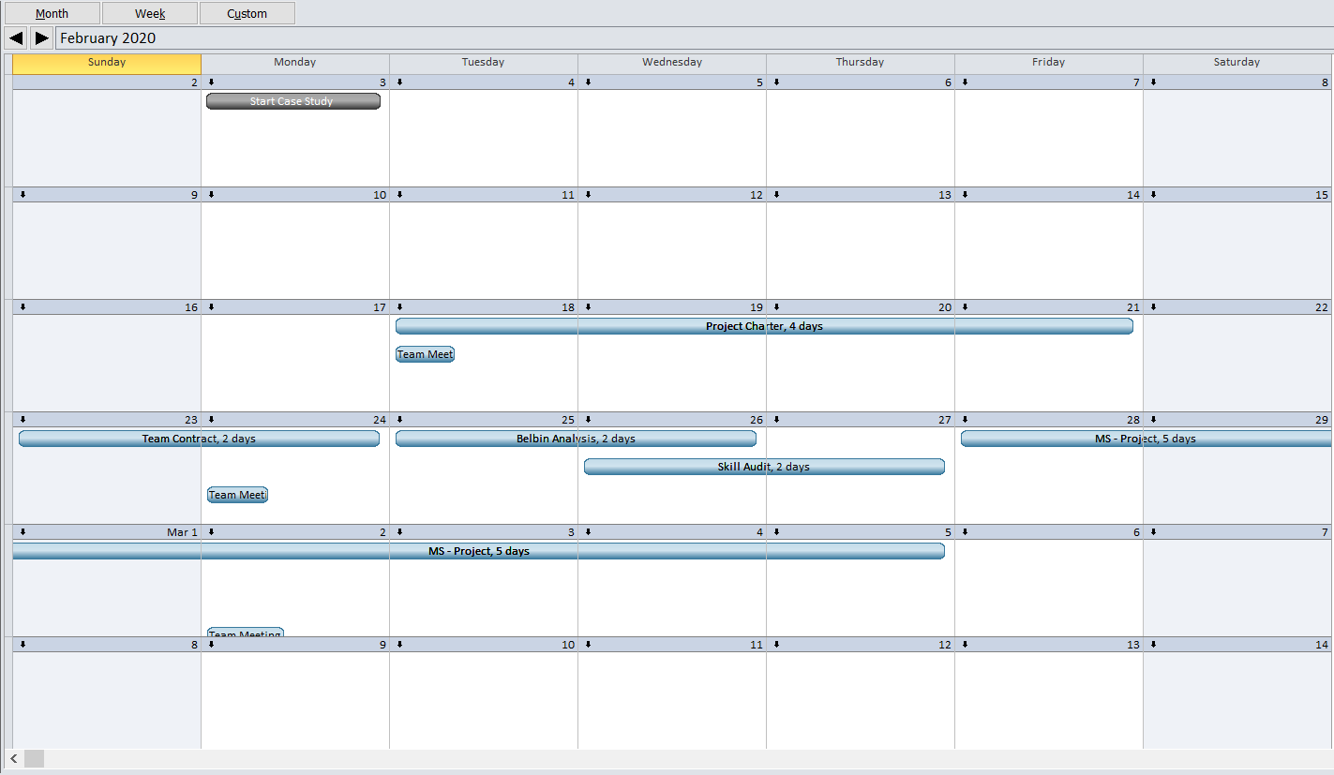
CALENDAR

Slide 37
RESOURCE SHEET

Slide 38
PROJECT TASK

Slide 39
Project Task

Slide 40
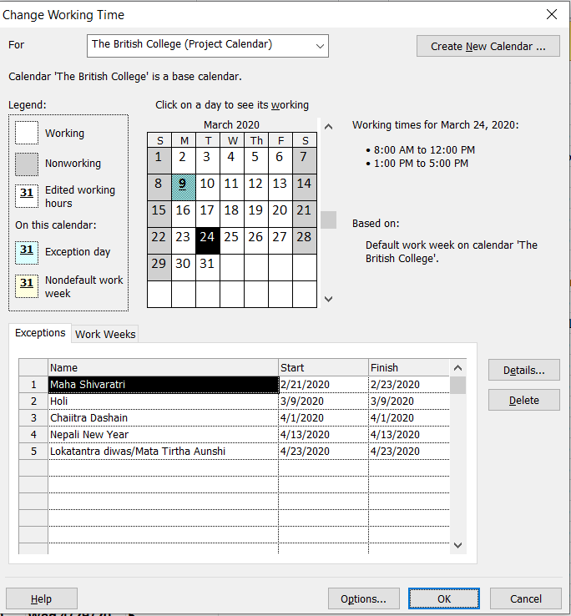
CHANGE WORKING TIME

Slide 41
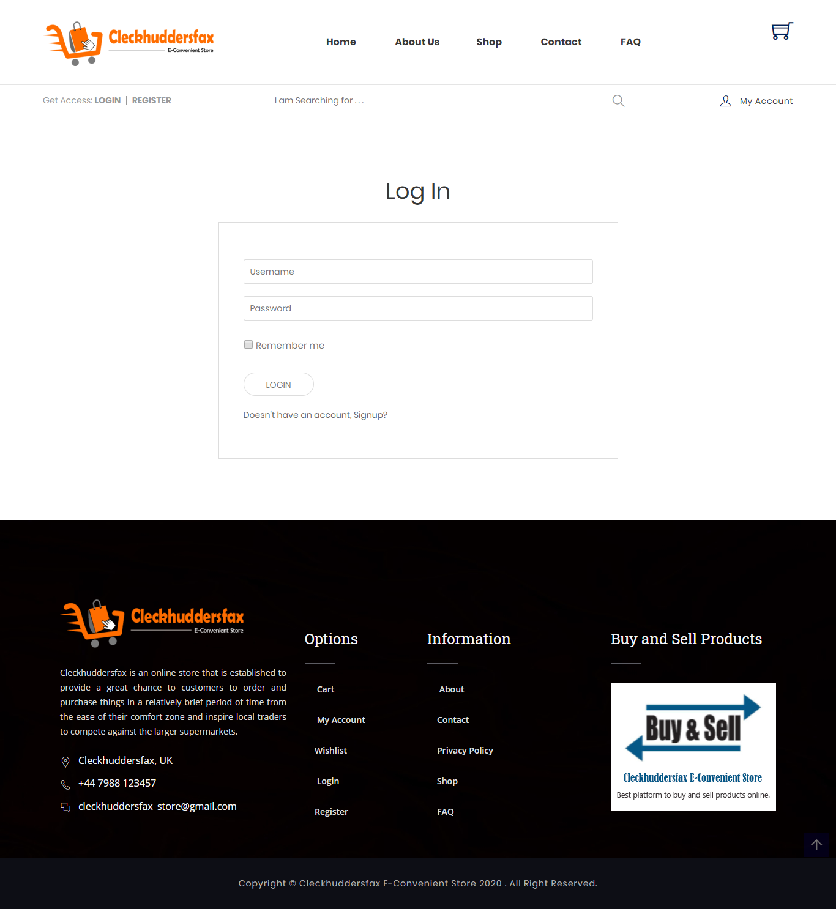
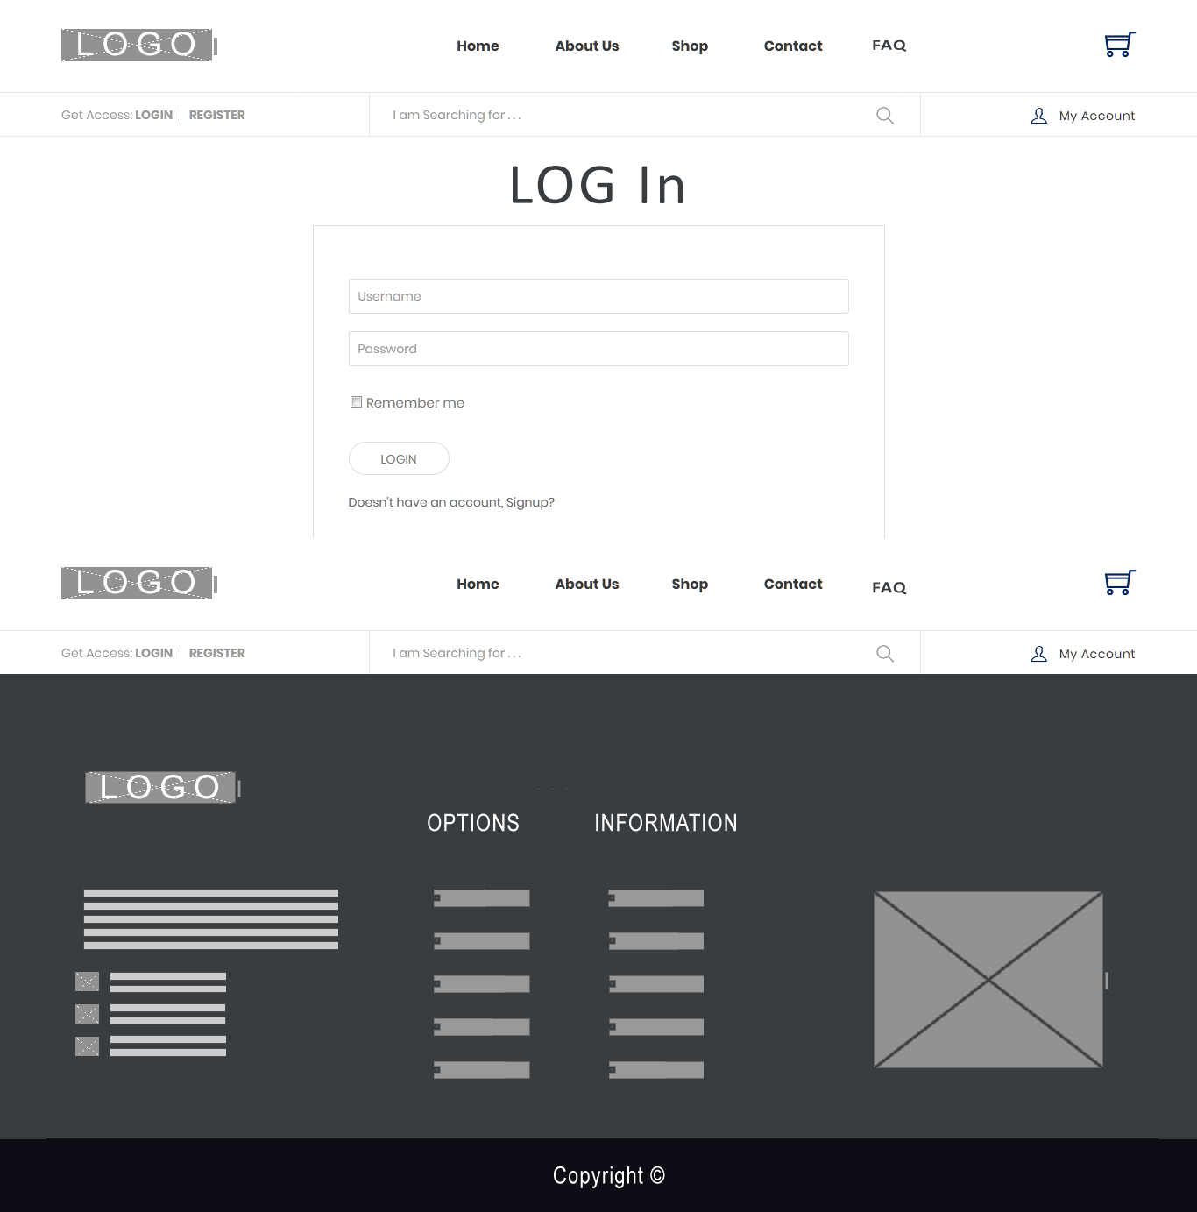
WIREFRAMES

Slide 42
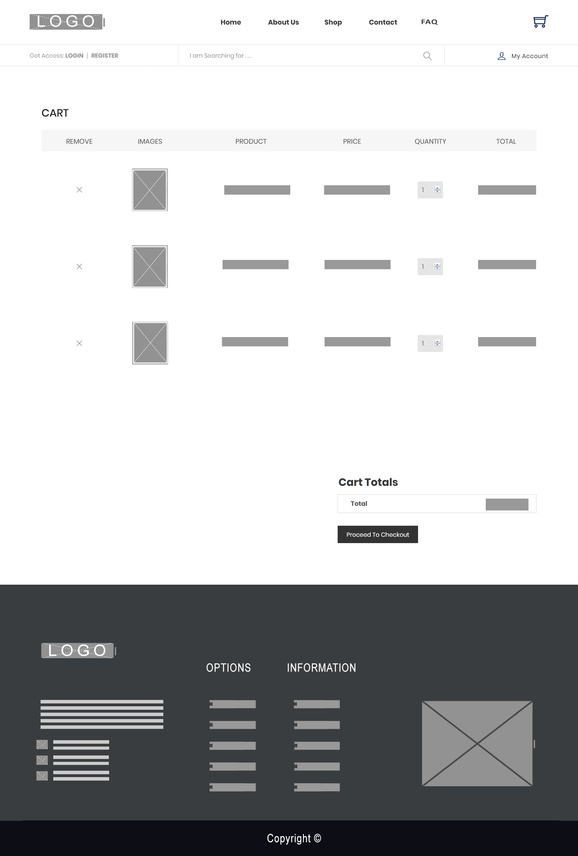
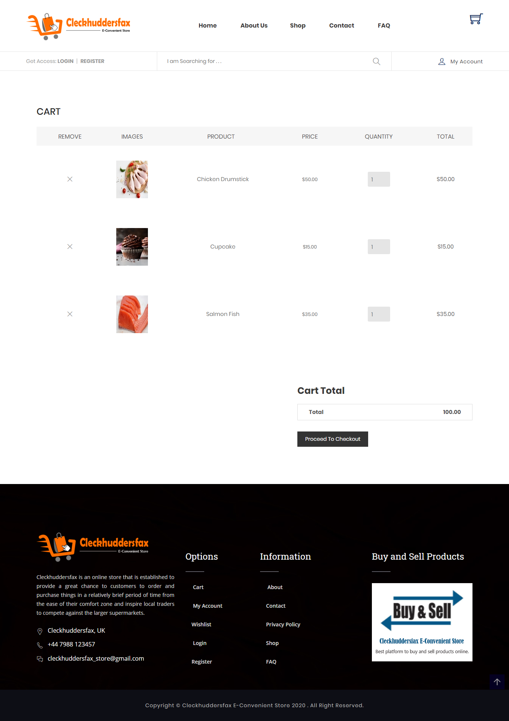
WIREFRAMES

Slide 43
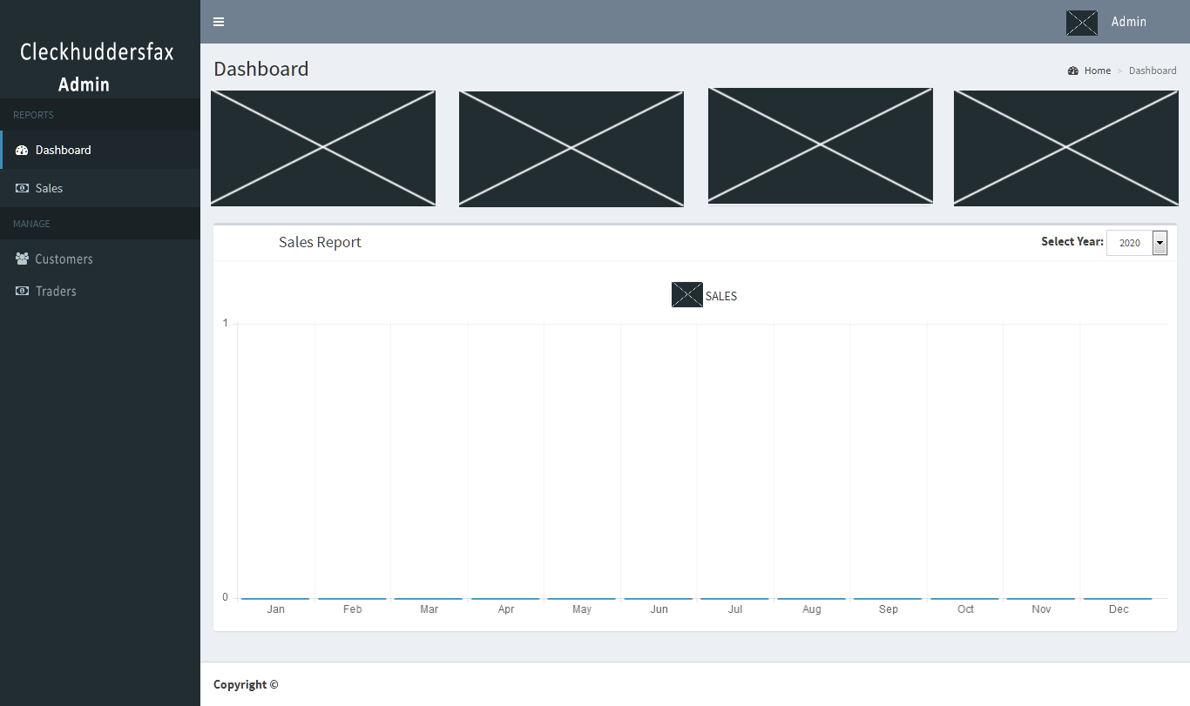
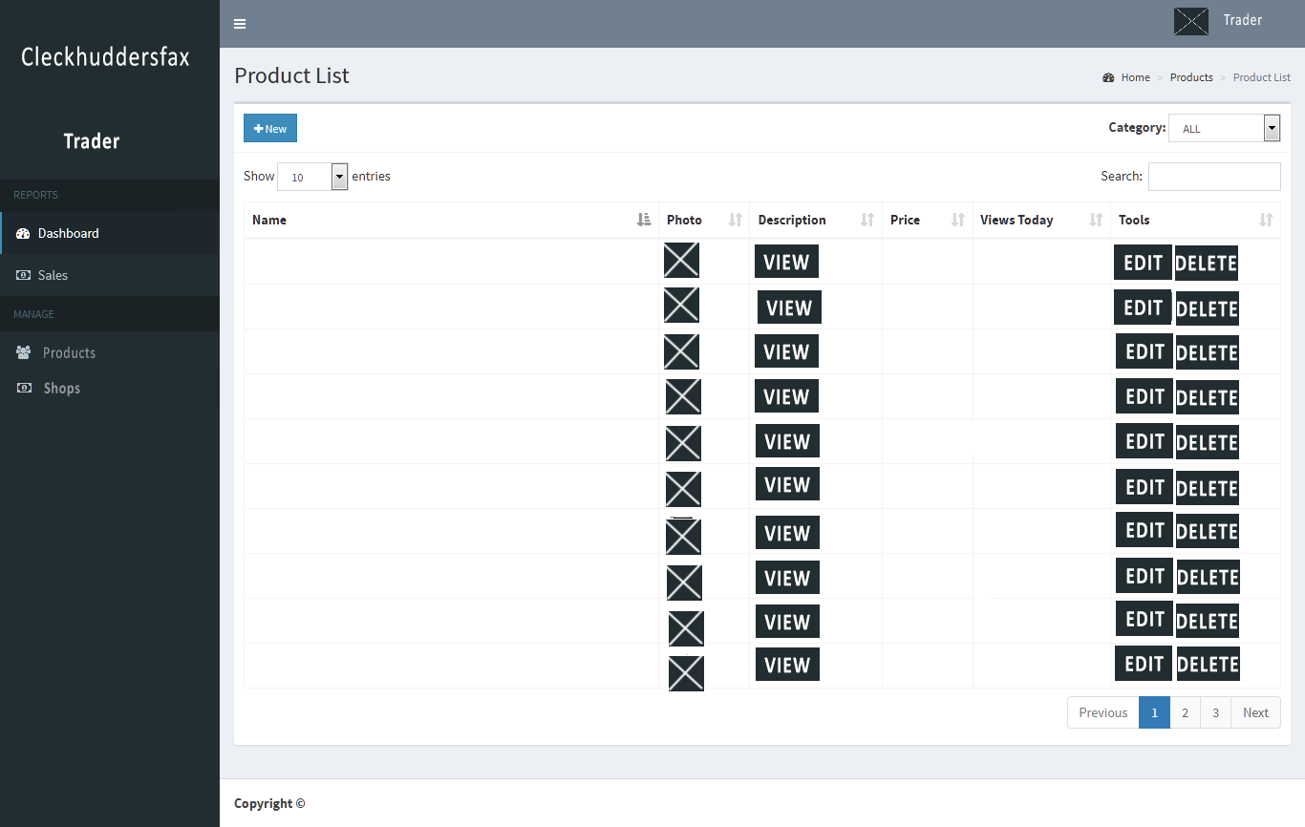
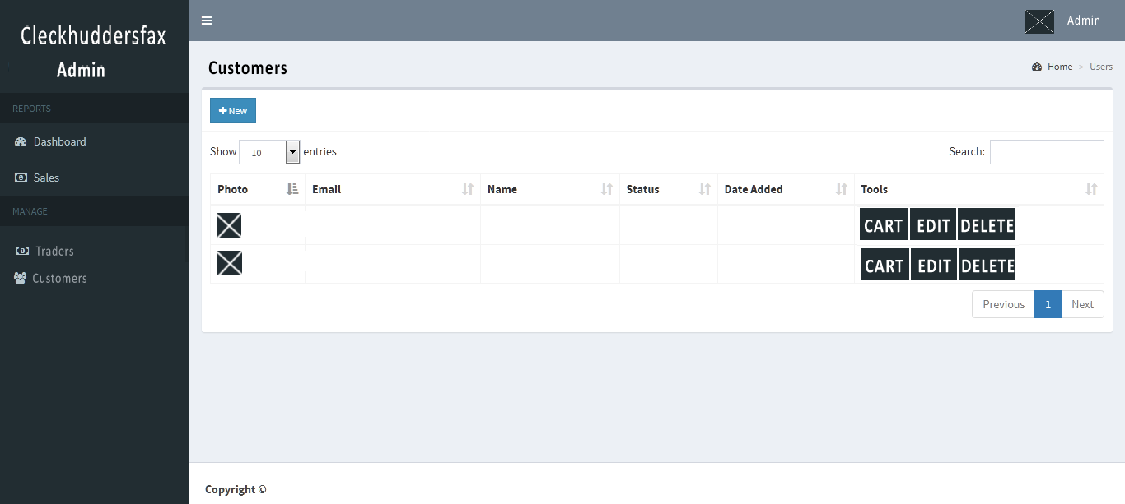
WIREFRAMES

Slide 44
TIMELINE
1ST WEEK
PROJECT INITIATION
Project Charter, Project Contract
PROJECT MONITORING AND CONTROLLING
FROM WEEK 4TH UNTIL PROJECT CLOSING
4TH WEEK
PROJECT PLANNING
Belbin’s Analysis, MS Project, Skill Audit
Testing Functionality
User Guides
8TH WEEK
PROJECT EXECUTING
Design, Implementation and Coding, APEX Oracle Tables, Pictorials, Website Mockups and Wireframes
12TH WEEK
PROJECT CLOSING
Project Presentation, Documentation

Slide 45

THANK YOU!
GROUP 3
FACILITATOR
THE BRITISH COLLEGE, KATHMANDU
Email:
cleckhuddersfax_store@gmail.com

